Slide 1
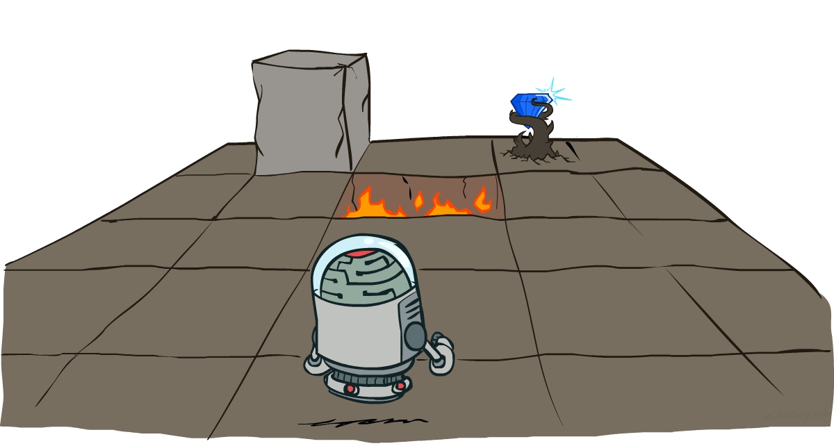
Artificial Intelligence
Markov Decision Processes (Part 2)
CS 444 – Spring 2021
Dr. Kevin Molloy
Department of Computer Science
James Madison University
Much of this lecture is taken from
Dan Klein and Pieter Abbeel AI class at UC Berkeley

Slide 2
Announcements
HW 6 is will be release tomorrow. Due next Tuesday evening.
Quiz 3a will be published Tuesday after class and due before class on Thursday (March 11th) (so, March 10th in reality).

Slide 3





Example: Grid World
A maze-like problem
The agent lives in a grid
Walls block the agent’s path
Noisy movement: actions do not always go as planned
80% of the time, the action North takes the agent North (if there is no wall there)
10% of the time, North takes the agent West; 10% East
If there is a wall in the direction the agent would have been taken, the agent stays put
The agent receives rewards each time step
Small “living” reward each step (can be negative)
Big rewards come at the end (good or bad)
Goal: maximize sum of rewards
Figure from Berkley AI

Slide 4
Recap: MDPs
Markov decision processes:
Set of states S
Start state s₀
Set of actions A
Transitions P(s’|s,a) (or T(s,a,s’))
Rewards R(s,a,s’) (and discount γ)
MDP quantities so far:
Policy = Choice of action for each state
Utility = sum of (discounted) rewards
s
a
s, a
s,a,s’
s’
Figure from Berkley AI

Slide 5
Optimal Quantities
The value (utility) of a state s:
V*(s) = expected utility starting in s and acting optimally
The value (utility) of a q-state (s,a):
Q*(s,a) = expected utility starting out having taken action a from state s and (thereafter) acting optimally
The optimal policy:
π*(s) = optimal action from state s
s
s is a state
a
(s, a) is a q-state
s, a
s,a,s’
(s,a,s’) is a transition
s’
Figure from Berkley AI

Slide 6
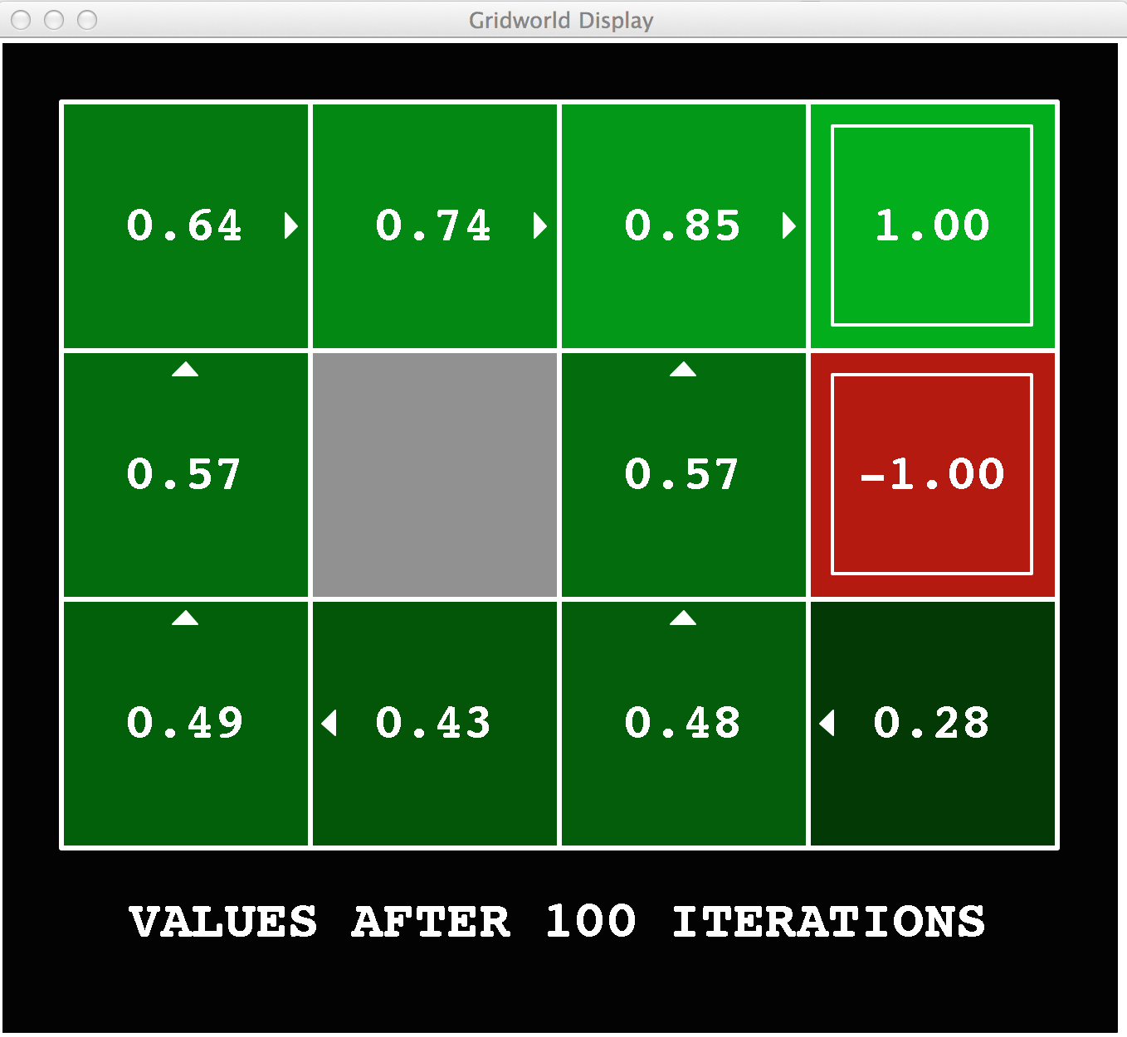
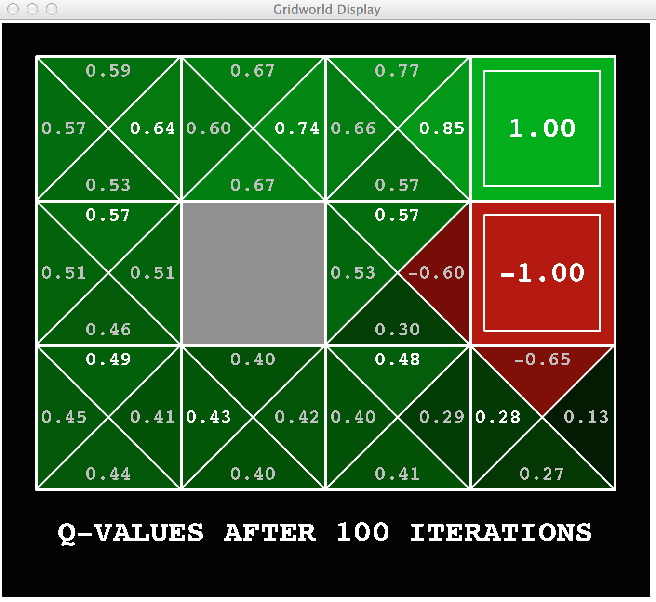
Gridworld Values V* and Q*
Figure from Berkley AI

Slide 7

The Bellman Equations
How to be optimal:
Step 1: Take correct first action
Step 2: Keep being optimal
Figure from Berkley AI

Slide 8


The Bellman Equations
Definition of “optimal utility” via expectimax recurrence gives a simple one-step lookahead relationship amongst optimal utility values
These are the Bellman equations, and they characterize optimal values in a way we’ll use over and over
s
a
s, a
s,a,s’
s’
Figure from Berkley AI

Slide 9
Value Iteration
Bellman equations characterize the optimal values:
Value iteration computes them:
Value iteration is just a fixed point solution method
… though the V_{k} vectors are also interpretable as time-limited values
V(s)
a
s, a
s,a,s’
V(s’)
Figure from Berkley AI

Slide 10
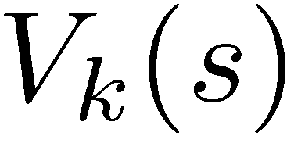
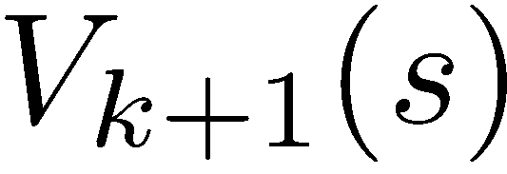
Convergence*
How do we know the V_{k} vectors are going to converge?
Case 1: If the tree has maximum depth M, then V_{M} holds the actual untruncated values
Case 2: If the discount is less than 1
Sketch: For any state V_{k} and V_{k+1} can be viewed as depth k+1 expectimax results in nearly identical search trees
The difference is that on the bottom layer, V_{k+1} has actual rewards while V_{k} has zeros
That last layer is at best all R_{MAX}
It is at worst R_{MIN}
But everything is discounted by γ^{k} that far out
So V_{k} and V_{k+1} are at most γ^{k} max|R| different
So as k increases, the values converge
Figure from Berkley AI

Slide 11
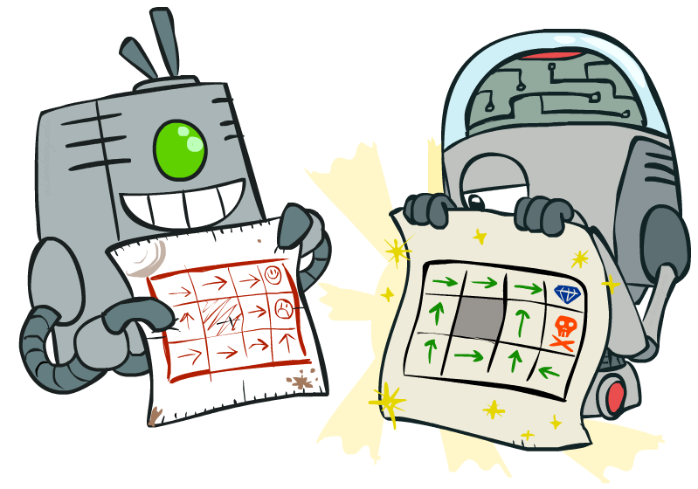
Policy Methods
Figure from Berkley AI

Slide 12

Policy Evaluation
Figure from Berkley AI

Slide 13
Fixed Policies
Do the optimal action
Do what π says to do
s
s
a
π(s)
s, a
s, π(s)
s,a,s’
s, π(s),s’
s’
s’
Expectimax trees max over all actions to compute the optimal values
If we fixed some policy π(s), then the tree would be simpler – only one action per state
… though the tree’s value would depend on which policy we fixed
Figure from Berkley AI

Slide 14
Utilities for a Fixed Policy
Another basic operation: compute the utility of a state s under a fixed (generally non-optimal) policy
Define the utility of a state s, under a fixed policy π:
V^{π}(s) = expected total discounted rewards starting in s and following π
Recursive relation (one-step look-ahead / Bellman equation):
s
π(s)
s, π(s)
s, π(s),s’
s’
Figure from Berkley AI

Slide 15
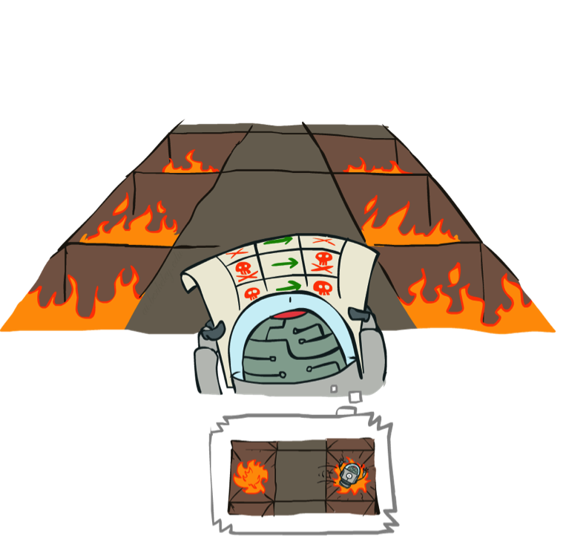
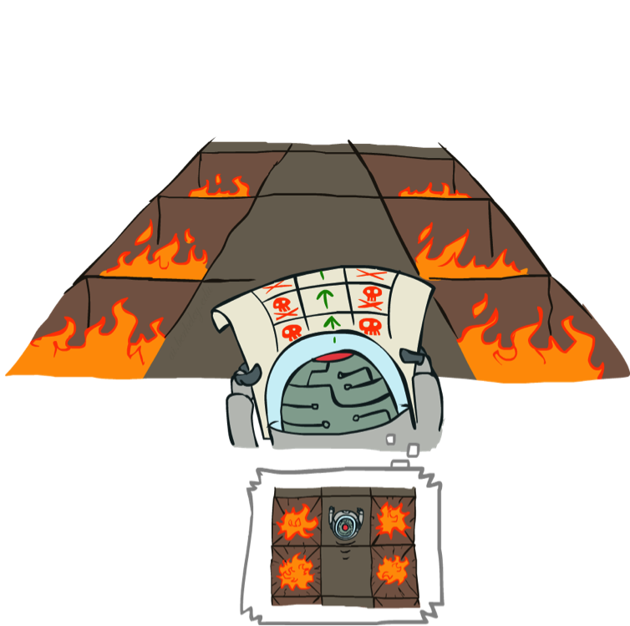
Example: Policy Evaluation
Always Go Right
Always Go Forward
Figure from Berkley AI

Slide 16
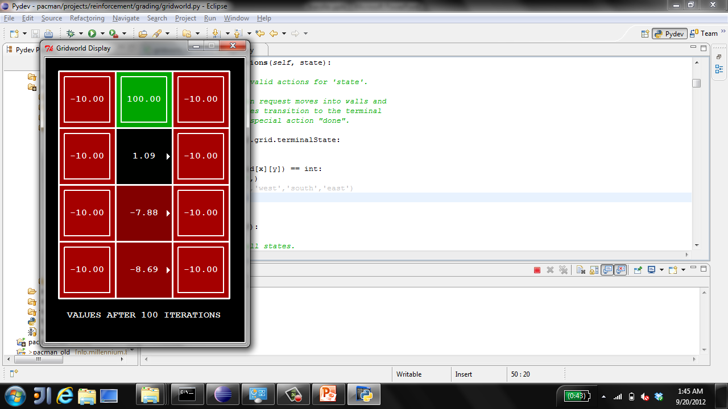
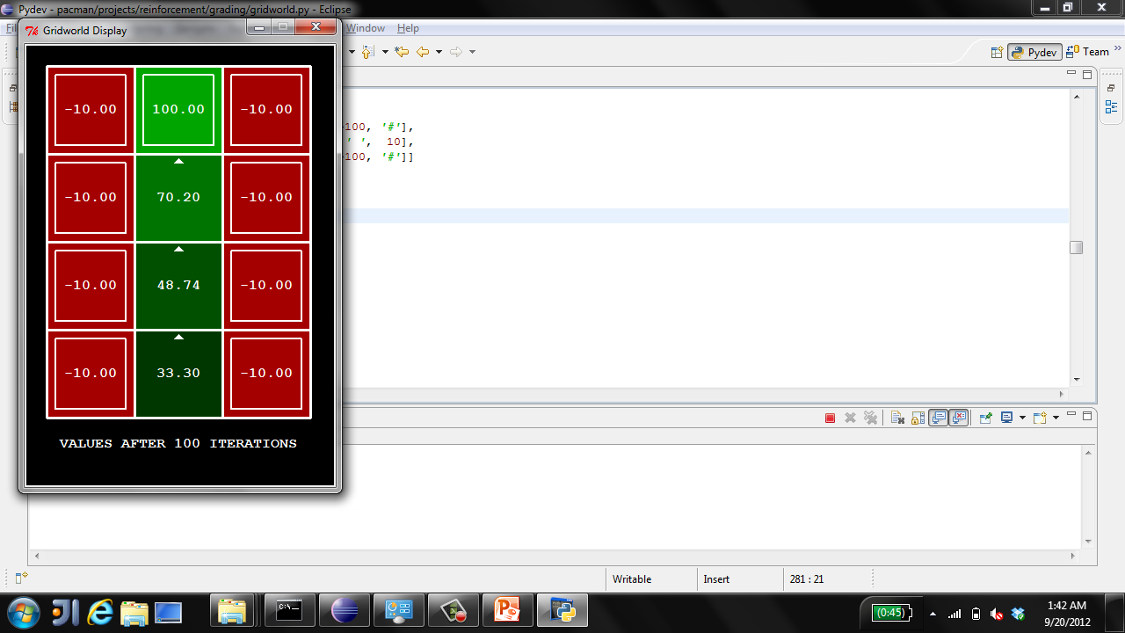
Example: Policy Evaluation
Always Go Right
Always Go Forward
Figure from Berkley AI

Slide 17

Policy Evaluation
s
How do we calculate the V’s for a fixed policy π?
Idea 1: Turn recursive Bellman equations into updates
(like value iteration)
Efficiency: O(S²) per iteration
Idea 2: Without the maxes, the Bellman equations are just a linear system
Solve with Matlab (or your favorite linear system solver)
π(s)
s, π(s)
s, π(s),s’
s’
Figure from Berkley AI

Slide 18
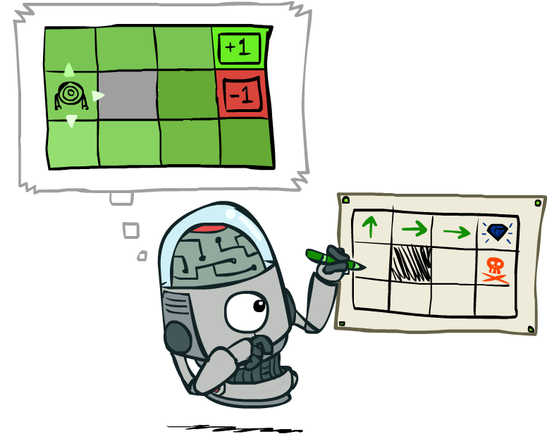
Policy Extraction
Figure from Berkley AI

Slide 19
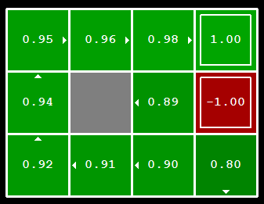
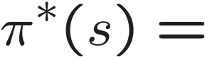
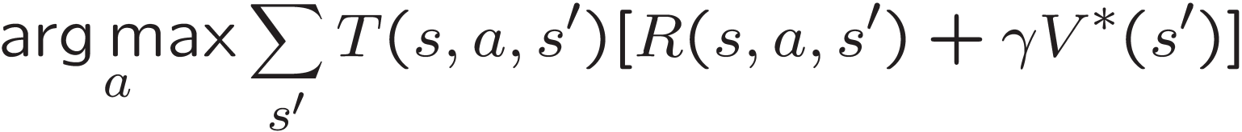
Computing Actions from Values
Let’s imagine we have the optimal values V*(s)
How should we act?
It’s not obvious!
We need to do a mini-expectimax (one step)
This is called policy extraction, since it gets the policy implied by the values
Figure from Berkley AI

Slide 20
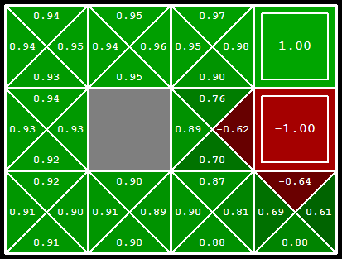
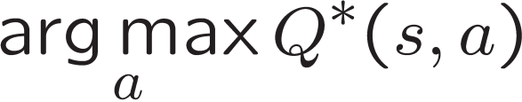
Computing Actions from Q-Values
Let’s imagine we have the optimal q-values:
How should we act?
Completely trivial to decide!
Important lesson: actions are easier to select from q-values than values!
Figure from Berkley AI

Slide 21

Policy Iteration
Figure from Berkley AI

Slide 22
Problems with Value Iteration
Value iteration repeats the Bellman updates:
Problem 1: It’s slow – O(S²A) per iteration
Problem 2: The “max” at each state rarely changes
Problem 3: The policy often converges long before the values
s
a
s, a
s,a,s’
s’
Figure from Berkley AI

Slide 23
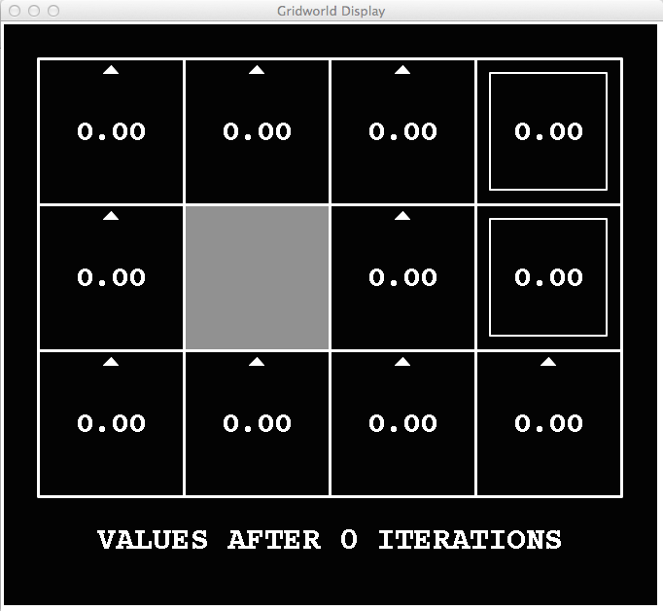
k = 0
Noise = 0.2
Discount = 0.9
Living reward = 0
Figure from Berkley AI

Slide 24
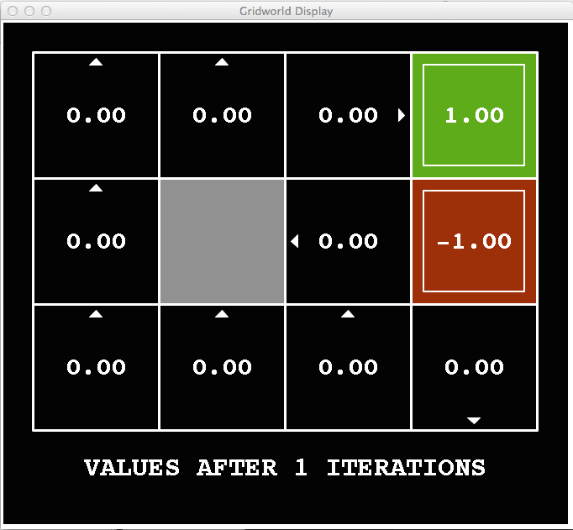
k = 1
Noise = 0.2
Discount = 0.9
Living reward = 0
Figure from Berkley AI

Slide 25
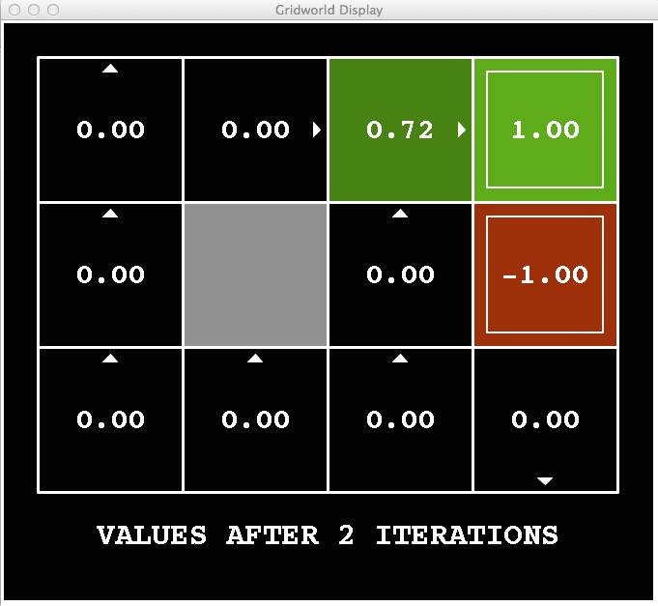
k = 2
Noise = 0.2
Discount = 0.9
Living reward = 0
Figure from Berkley AI

Slide 26
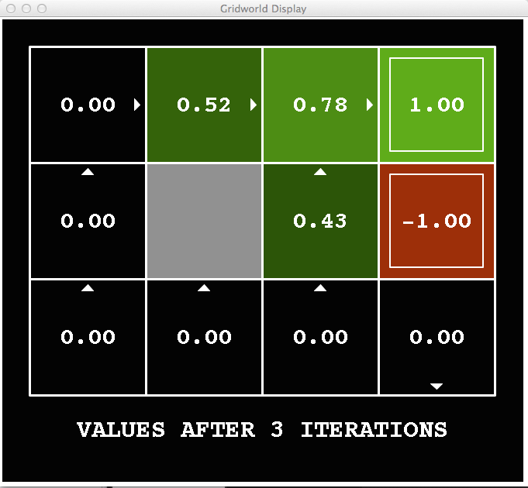
k = 3
Noise = 0.2
Discount = 0.9
Living reward = 0
Figure from Berkley AI

Slide 27
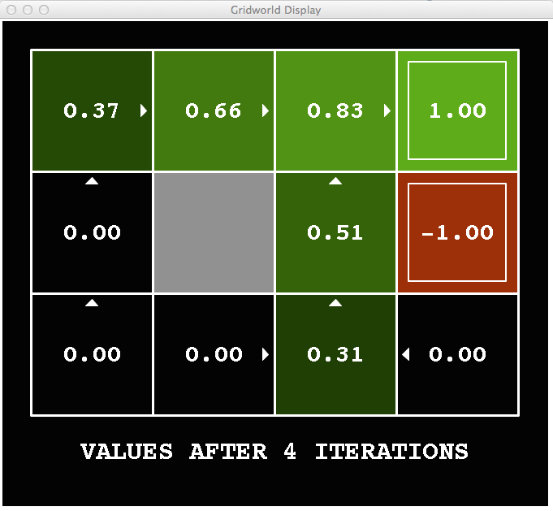
k = 4
Noise = 0.2
Discount = 0.9
Living reward = 0
Figure from Berkley AI

Slide 28
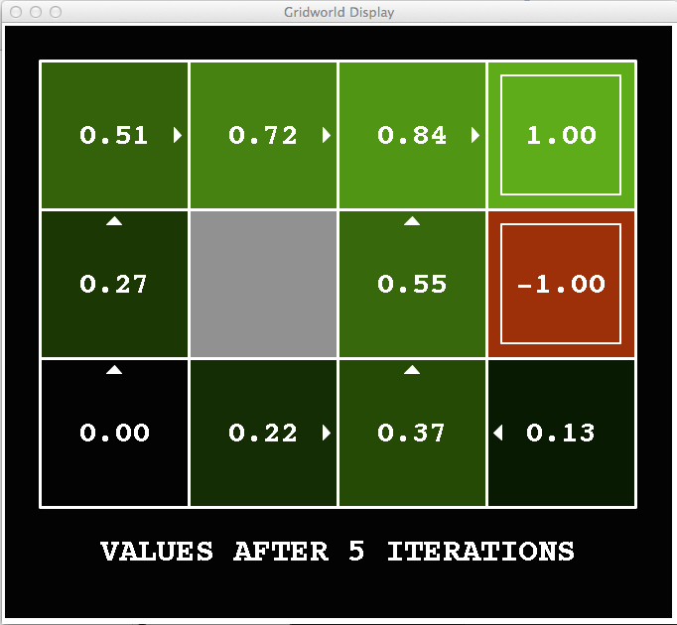
k = 5
Noise = 0.2
Discount = 0.9
Living reward = 0
Figure from Berkley AI

Slide 29
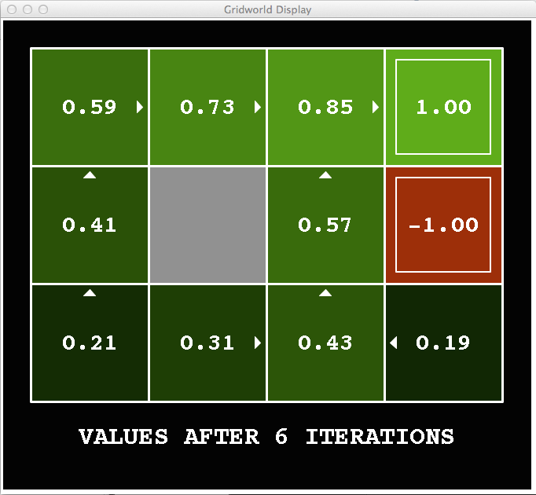
k = 6
Noise = 0.2
Discount = 0.9
Living reward = 0
Figure from Berkley AI

Slide 30
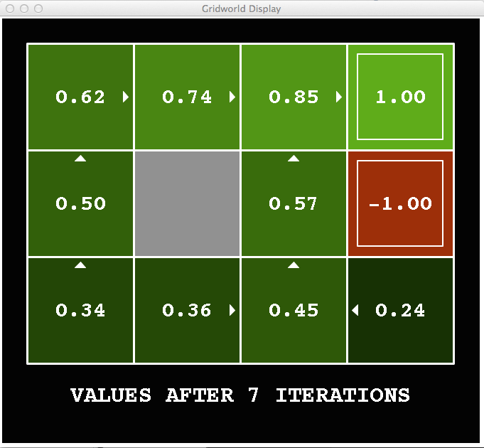
k = 7
Noise = 0.2
Discount = 0.9
Living reward = 0
Figure from Berkley AI

Slide 31
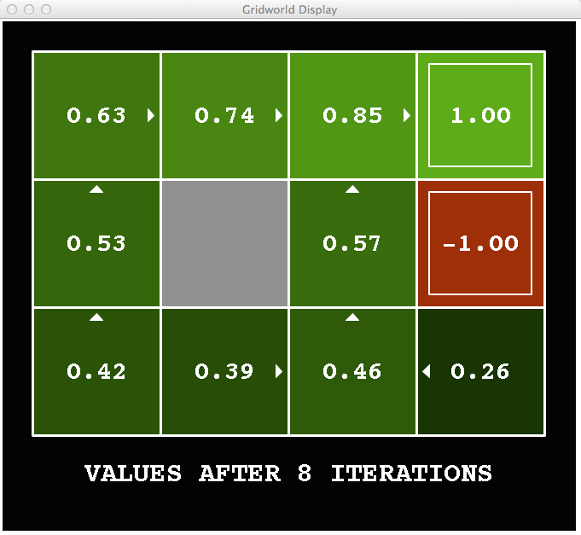
k = 8
Noise = 0.2
Discount = 0.9
Living reward = 0
Figure from Berkley AI

Slide 32
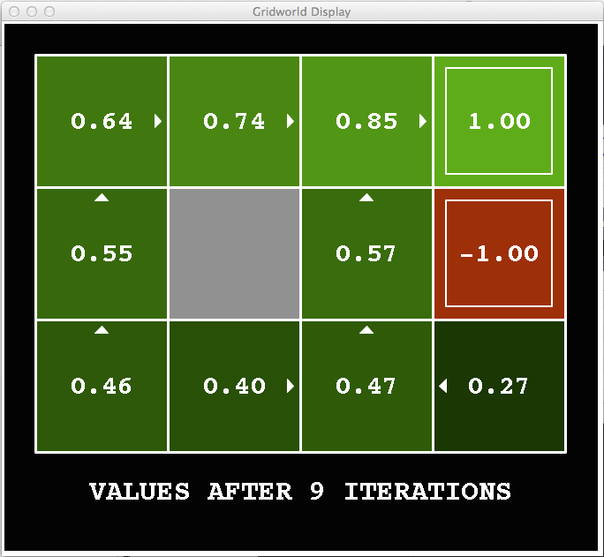
k = 9
Noise = 0.2
Discount = 0.9
Living reward = 0
Figure from Berkley AI

Slide 33

k = 10
Noise = 0.2
Discount = 0.9
Living reward = 0
Figure from Berkley AI

Slide 34

k = 11
Noise = 0.2
Discount = 0.9
Living reward = 0
Figure from Berkley AI

Slide 35
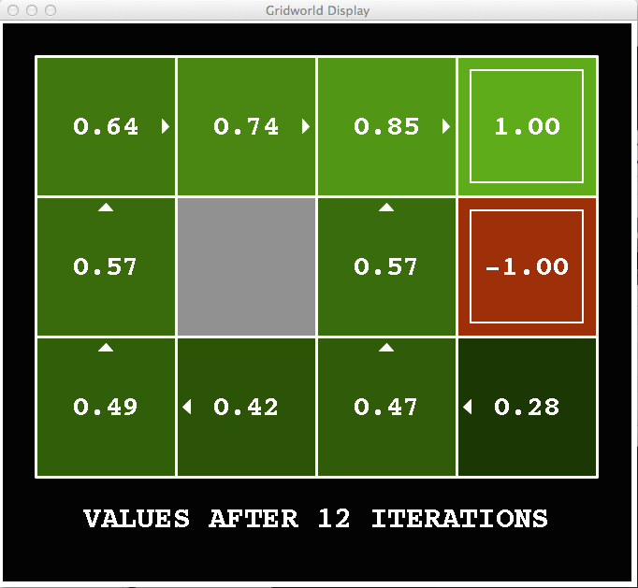
k = 12
Noise = 0.2
Discount = 0.9
Living reward = 0
Figure from Berkley AI

Slide 36
Policy Iteration
Alternative approach for optimal values:
Step 1: Policy evaluation: calculate utilities for some fixed policy (not optimal utilities!) until convergence
Step 2: Policy improvement: update policy using one-step look-ahead with resulting converged (but not optimal!) utilities as future values
Repeat steps until policy converges
This is policy iteration
It’s still optimal!
Can converge (much) faster under some conditions
Figure from Berkley AI

Slide 37
Comparison
Evaluation: For fixed current policy π, find values with policy evaluation:
Iterate until values convee:
Improvement: For fixed values, get a better policy using policy extraction
One-step look-ahead:
Figure from Berkley AI

Slide 38
Comparison
Both value iteration and policy iteration compute the same thing (all optimal values)
In value iteration:
Every iteration updates both the values and (implicitly) the policy
We don’t track the policy, but taking the max over actions implicitly recomputes it
In policy iteration:
We do several passes that update utilities with fixed policy (each pass is fast because we consider only one action, not all of them)
After the policy is evaluated, a new policy is chosen (slow like a value iteration pass)
The new policy will be better (or we’re done)
Both are dynamic programs for solving MDPs
Figure from Berkley AI

Slide 39
Summary: MDP Algorithms
So you want to….
Compute optimal values: use value iteration or policy iteration
Compute values for a particular policy: use policy evaluation
Turn your values into a policy: use policy extraction (one-step lookahead)
These all look the same!
They basically are – they are all variations of Bellman updates
They all use one-step lookahead expectimax fragments
They differ only in whether we plug in a fixed policy or max over actions
Figure from Berkley AI

Slide 40

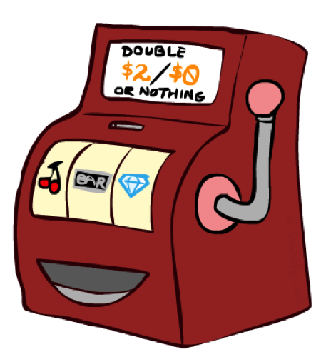

Double Bandits
Figure from Berkley AI

Slide 41
Double-Bandit MDP
Actions: Blue, Red
States: Win, Lose
No discount
100 time steps
Both states have the same value
0.25 $0
0.75
$2
W
L
0.25
$0
$1
1.0
$1
1.0
0.75 $2
Figure from Berkley AI

Slide 42
Offline Planning
Solving MDPs is offline planning
You determine all quantities through computation
You need to know the details of the MDP
You do not actually play the game!
No discount
100 time steps
Both states have the same value
0.25 $0
Value
0.75
$2
W
0.25
$0
Play Red
150
L
$1
1.0
$1
1.0
0.75 $2
Play Blue
100
Figure from Berkley AI

Slide 43
Let's Play!
$2
$2
$0
$2
$2
$2
$2
$0
$0
$0
Figure from Berkley AI

Slide 44
Online Planning
?? $0
??
$2
W
L
??
$0
$1
1.0
$1
1.0
?? $2
Figure from Berkley AI

Slide 45
Let's Play!
$0
$0
$0
$2
$0
$2
$0
$0
$0
$0
Figure from Berkley AI

Slide 46
What Just Happened?
That wasn’t planning, it was learning!
Specifically, reinforcement learning
There was an MDP, but you couldn’t solve it with just computation
You needed to actually act to figure it out
Important ideas in reinforcement learning that came up
Exploration: you have to try unknown actions to get information
Exploitation: eventually, you have to use what you know
Regret: even if you learn intelligently, you make mistakes
Sampling: because of chance, you have to try things repeatedly
Difficulty: learning can be much harder than solving a known MDP
Figure from Berkley AI

Slide 47
Next Time: Reinforcement Learning!
Figure from Berkley AI

